Slide 1
Unit-7
What is VHDL ?
VHDL stands for VHSIC (Very High Speed Integrated Circuits) Hardware Description Language. In the mid-1980’s the U.S. Department of Defense and the IEEE (Institute of Electrical and Electronics Engineers) sponsored the development of this hardware description language. Its goal was to develop very high-speed integrated circuit. It has become now one of industry’s standard languages used to describe digital systems. The other widely used hardware description language is Verilog.

Slide 2
Cont…
Both are powerful languages that allow us to describe and simulate complex digital systems. A third HDL language is ABEL (Advanced Boolean Equation Language) which was specifically designed for Programmable Logic Devices (PLD). ABEL is less powerful than the other two languages and is less popular in industry.

Slide 3
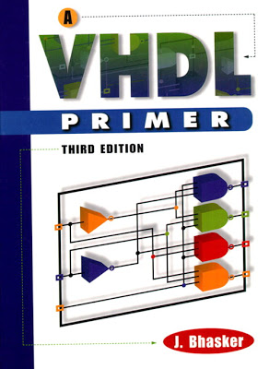

Slide 4
Role of HDLs
V
Very High Speed Integrated Circuit
H
Hardware
D
Description
L
Language
System description and documentation
System simulation
System synthesis

Slide 5
7.1. RTL design with VHDL
Register Transfer Level (RTL) describes a circuit’s registers and the sequence of transfers between these registers. But it does not describe the hardware used to carry out these operations.
The steps in RTL design are:
determine the number and sizes of registers needed to hold the data used by the device.
determine the logic and arithmetic operations that need to be performed on these register contents, and
design a state machine in order to obtain the desired results.

Slide 6
RTL vs HDL? What is the difference ?
HDL is the name for all hardware description languages (Verilog,VHDL, etc.) in the same way Object Oriented, or C++, Java, etc.
RTL, on the other hand, is a way of describing a circuit. You write your RTL level code in an HDL language.

Slide 7
Cont….
Here is a HDL for describing a mux in RTL:
assign mux_out = (sel) ? din_1 : din_0;

Slide 8
7.3. Shape (Structure) of VHDL
Shape refers to the typical parts of a single VHDL module.
A VHDL module contains two basic parts –
( a) one covers the connections made between this module and other modules and (b) the other part is an unambiguous (clear) description of the behavior of the module.

Slide 9
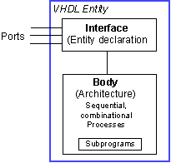
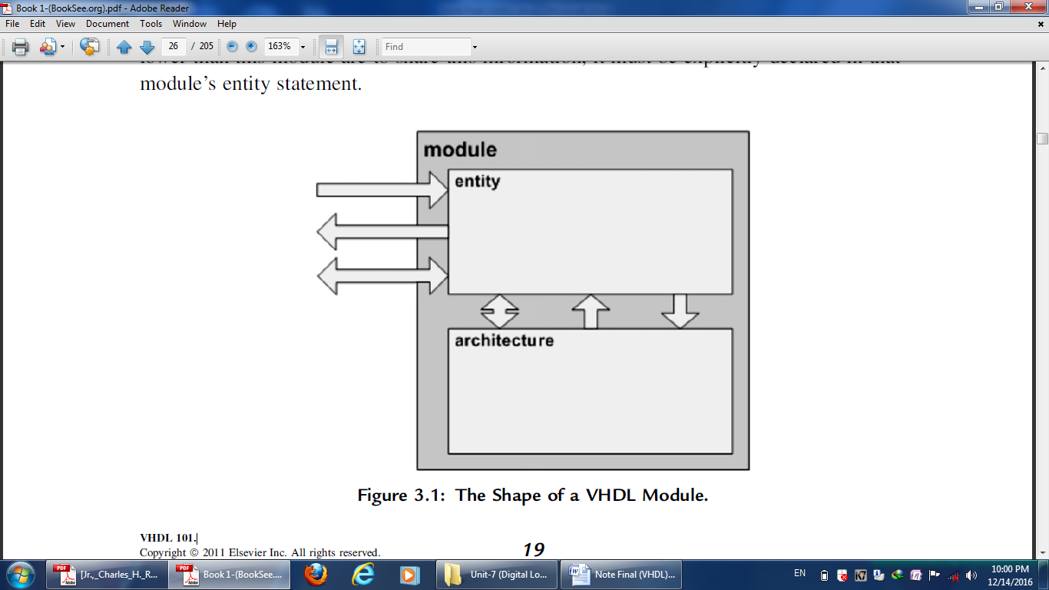
Cont…

Slide 10
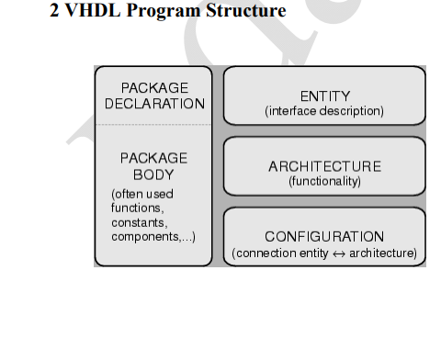

Slide 11
Cont…
VHDL uses reserved keywords that cannot be used as signal names or identifiers. Keywords and user-defined identifiers are case insensitive. Lines with comments start with two adjacent hyphens (--) and will be ignored by the compiler. VHDL also ignores line breaks and extra spaces. VHDL is a strongly typed language which implies that one has always to declare the type of every object that can have a value, such as signals, constants and variables.

Slide 12
Data Types
There are four classes of data types: scalar, composite, access and file types. The scalar types represent a single value and are ordered so that relational operations can be performed on them. The scalar type includes integer, real, and enumerated types of Boolean and Character.

Slide 13
Concurrent Statements
A VHDL architecture contains a set of concurrent statements. Each concurrent statement defines one of the interconnected blocks or processes that describe the overall behavior or structure of a design. Concurrent statements in a design execute continuously, unlike sequential statements, which execute one after another.
The two main concurrent statements are:
1. process statement
2. block statement

Slide 14
Variables:
Assignment to variables are scheduled immediately (the assignment takes effect immediately). If a variable is assigned a value, the corresponding location in memory is written with the new value while destroying the old value. This effectively happen immediately so if the next executing statement in the program uses the value of the variable, it is the new value that is used. Typically, variables are used as a local storage mechanism, visible only inside a process.

Slide 15
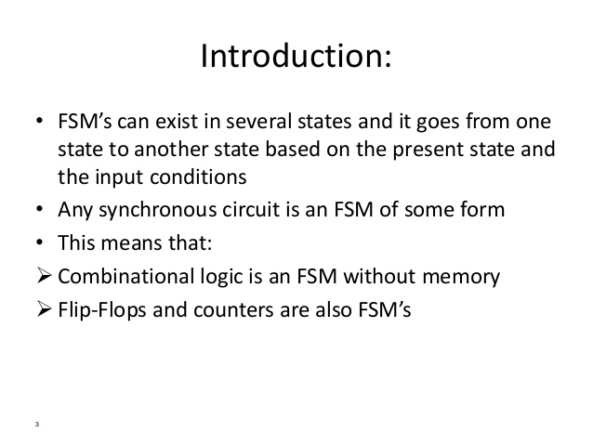
Finite State Machines

Slide 16
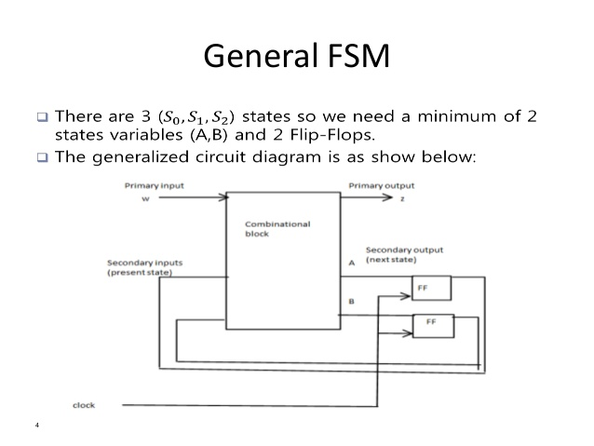

Slide 17
FSM design procedure
Describe FSM behavior, e.g. state diagram
Inputs and Outputs
States (symbolic)
State transitions
State diagram to state transition table, i.e. truth table
Inputs: inputs and current state
Outputs: outputs and next state
State encoding
decide on representation of states
lots of choices
Implementation
flip-flop for each state bit
synthesize combinational logic from encoded state table

Slide 18
Cont….
` When designing digital integrated circuits with a hardware description language, the designs are usually engineered at a higher level of abstraction than transistor level (logic families) or logic gate level. In HDLs, the designer declares the registers (which roughly correspond to variables in computer programming languages), and describes the combinational logic by using constructs that are familiar from programming languages such as if-then-else and arithmetic operations. This level is called register-transfer level. The term refers to the fact that RTL focuses on describing the flow of signals between registers.

